Slide 1

Smart Beach Project by MIC at Bruce county
Team members: Janvi Patel
: Fangji Chen
: Scaria Kurian
This Photo by Unknown author is licensed under CC BY-NC.

Slide 2
Project Description
Beaches around Lake Huron are popular tourist destinations. However, there are some potential risks such as quick underwater rip currents. Local community organizations are seeking solutions to educate and maintain beach safety. This project is part of the three-year Smart Beach project administered by the Municipal Innovation Council (MIC). It aims to use innovative technologies to improve beach safety. Launched at Station Beach in Kincardine on May 25, 2022, the research team of the Smart Beach project has collected weather and wave data using a RAEON (Real-time Aquatic Ecosystem Observation Network) buoy in Lake Huron from Spring to Autumn in 2022. This project aims to utilize the collected buoy data and the publicly available Environmental Canada and NOAA data to examine if the inshore water movement (wave conditions and currents) and drowning incidents can be predicted by the offshore buoy data and weather conditions. The results of machine learning models are expected to support the Smart Beach project further to develop a realtime beach security information system for beachgoers and improve safety at Kincardine’s Station Beach

Slide 3
AI Team
Our task as AI team will be working on object detection and image processing of the anonymized data provided by the client.
As per the results of the machine learning algorithm the Big Data team performed, we will assessing how many people were there on the beach in which weather condition. It will be helpful to predict swimming conditions.
Predict the wave conditions and current visible in the camera images, as well as the number and distribution of people on the beach and in the water. Data provided: anonymized images from the camera. This will be provided later once the images are anonymized, with a focus on providing the model set first.

Slide 4
Anonymizing Image
According to GDPR " information which does not relate to an identified or identifiable natural person or to personal data rendered anonymous in such a manner that the data subject is not or no longer identifiable ".
There are 3 ways of it: Blurring the image.
: Lowering the resolution of that area.
: Replacing face with solid color.
This can be done either manually or automatically (Use of AI and deep learning by a software).

Slide 5
Some effective automatic tools
Red hat developer: link
Anonymazing: link (100 Euro per 10,000 images)
Brighter AI: link
The last one is recommended by us.

Slide 6
Brighter AI
Easy-to-use: Simple integration via cloud API or online user interface
Precise: >99% anonymization accuracy
Fast: Fully automatic, AI-powered anonymization software
Secure: Hosted on MS Azure with TLS encrypted API
AI-compatible: Deep Natural Anonymization (DNAT) enables analytics and machine learning compatibility
Compliance: Anonymized data by nature not personal and therefore not subject to data privacy regulations (GDPR, CCPA, CSL/PIS, etc.)

Slide 7
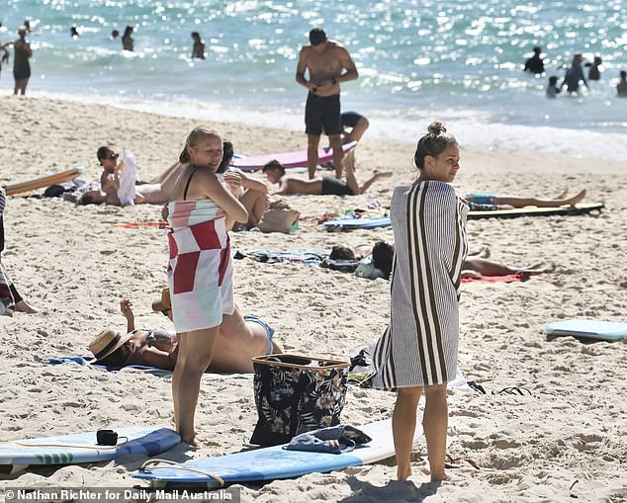
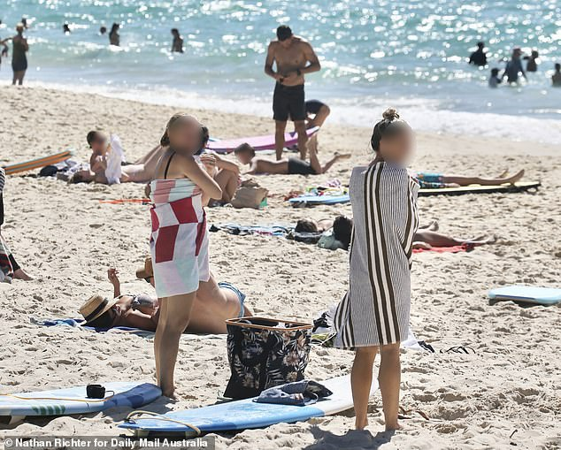
Results of Brighter AI
Before: After:

